Slide 1

Cricket T20 Analysis
Best 11 Players

Slide 2
Problem Statement
Create a team of Best 11 Players from among all the players who played in T20 world cup final
The team should be able to score at least 180 runs on an average
They should be able to defend at least 150 runs on an average

Slide 3
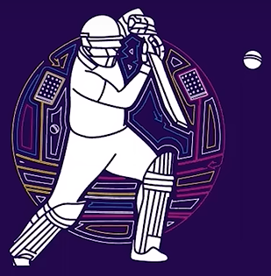
OPENERS
Parameters | Description | Criteria
Batting Average | Average runs scored in an innings | >30
Strike Rate | No of runs scored per 100 balls | >140
Innings Batted | Total innings batted | >3
Boundary % | % of runs scored in boundaries | >50
Batting Position | Order in which the batter played | <4
This Partnership would be able to give us at least 50 runs in 1st five overs

Slide 4
ANCHORS / MIDDLE ORDER
Parameters | Description | Criteria
Batting Average | Average runs scored in an innings | >40
Strike Rate | No of runs scored per 100 balls | >125
Innings Batted | Total innings batted | >3
Avg. Balls Faced | Average balls faced by a batter in an innings | >20
Batting Position | Order in which the batter played | >2
We have 3 players as anchors and now as overall we have 5 players which will give us at least a score of 120+

Slide 5
FINISHER / LOWER ORDER ANCHOR
Parameters | Description | Criteria
Batting Average | Average runs scored in an innings | >25
Strike Rate | No of runs scored per 100 balls | >130
Innings Batted | Total innings batted | >3
Avg. Balls Faced | Average balls faced by a batter in an innings | >12
Batting Position | Order in which the batter played | >4
Innings Bowled | Total innings bowled by the bowler | >1
Single player who will hit like crazy but if we loose middle order so badly, so this person will be able to stabilize the innings and order the rest of the lower order batsmasn

Slide 6
ALL-ROUNDERS/ LOWER ORDER
Parameters | Description | Criteria
Batting Average | Average runs scored in an innings | >15
Strike Rate | No of runs scored per 100 balls | >140
Innings Batted | Total innings batted | >2
Bowling Economy | Average runs allowed per over | <7
Batting Position | Order in which the batter played | >4
Innings Bowled | Total innings bowled by the bowler | >2
Bowling Strike Rate | Average no of balls required to take a wicket | <20
So our 6th and 7th player will be All Rounders. Mostly these can be spinners. So, these spinners are the ones who can hit and start hitting without thinking in the last overs

Slide 7

SPECIALIST FAST BOWLERS
Parameters | Description | Criteria
Innings Bowled | Total Innings Bowled | >4
Bowling Economy | Average runs allowed per over | <7
Bowling Strike Rate | Average no of balls required to take a wicket | <16
Bowling Style | Bowling style of the player | =“%fast%”
Bowling Average | No of runs allowed per wicket | <20
Dot Ball % | % of dot balls bowled | >40
Our last 3 players are the fast bowlers which can take wickets at least every 16 balls or less. They can bowl vey fast and bowl dot balls over 40% which is great for a T20 game.

Slide 8
Execution of Project Plan
Web Scraping
Python
Visualization
Data collection of T20 world cup final from the website espncricinfo.com
Data pre processing and cleaning on null and noise values in pandas
Creating various charts and generating insights in power bi and then creating a dashboard and selecting our final 11 players.

Slide 9
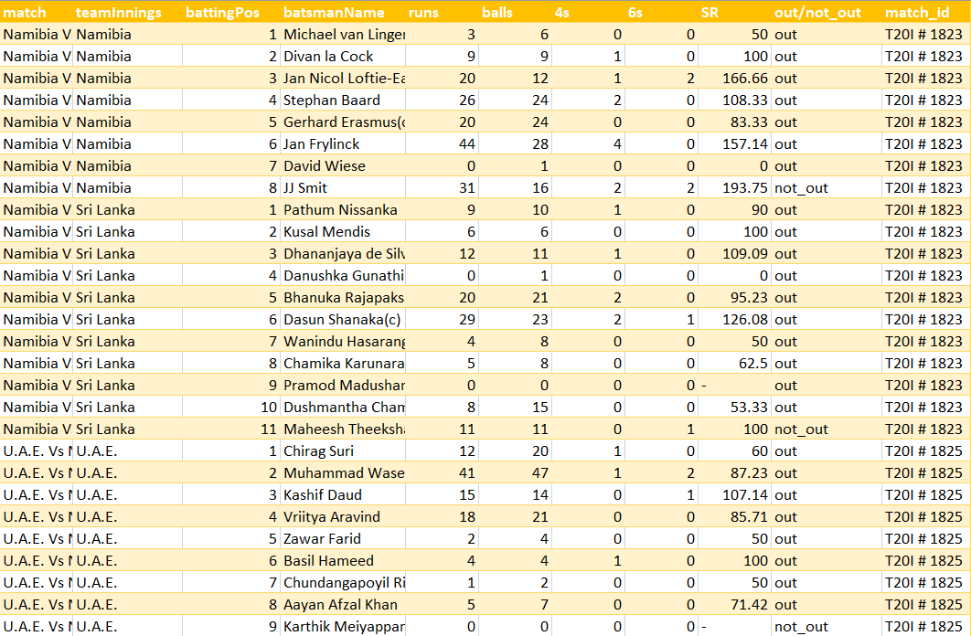
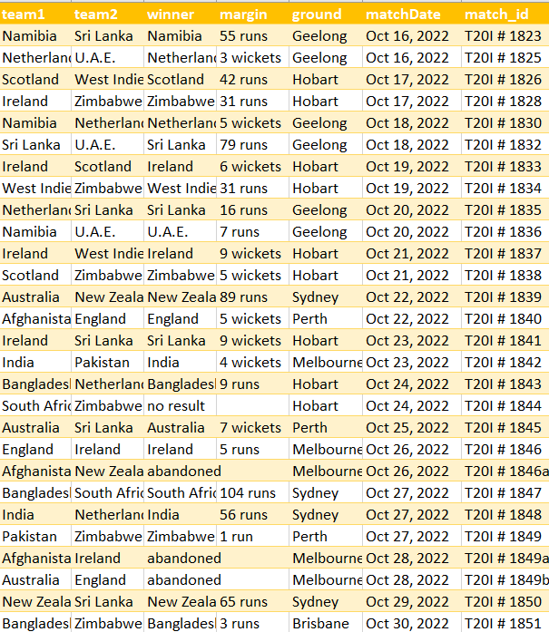
Batting Summary
Match Summary

Slide 10
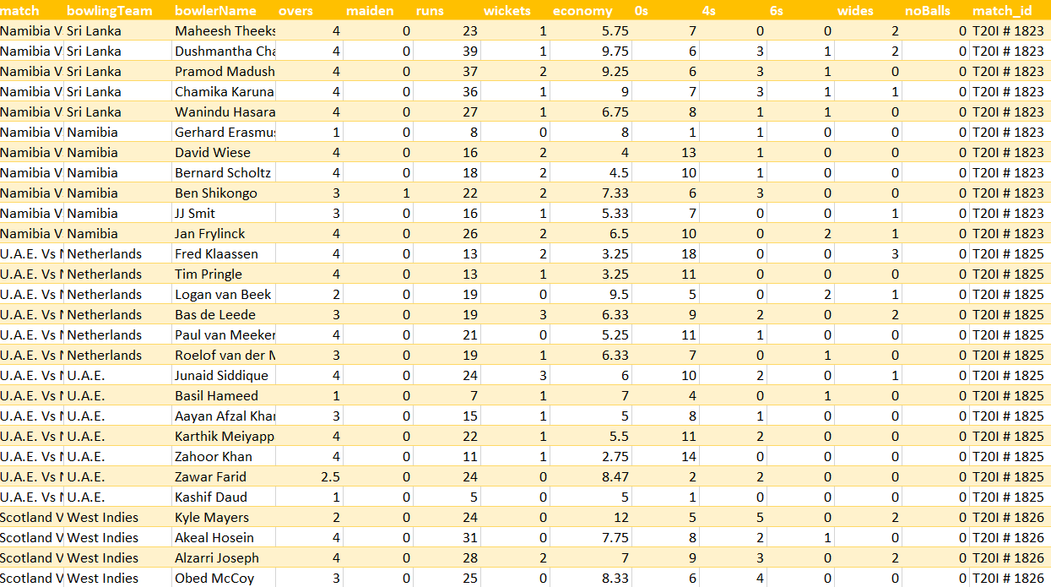
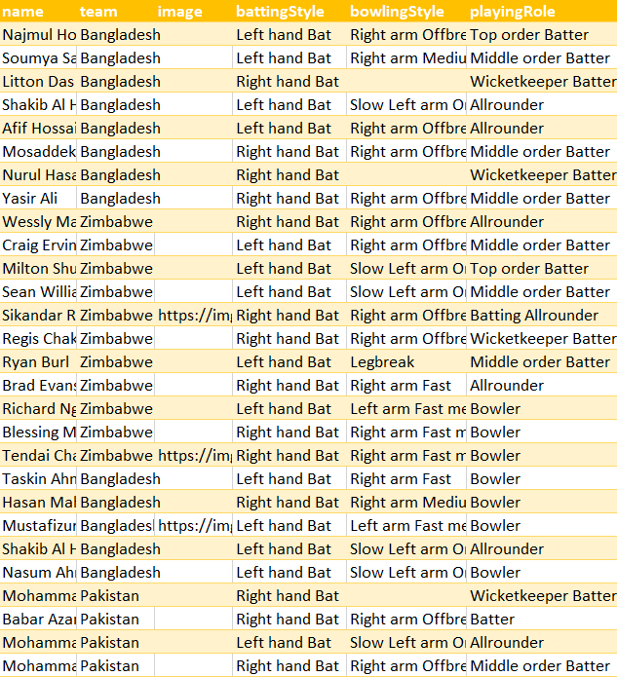
Bowling Summary
Players Summary

Slide 11
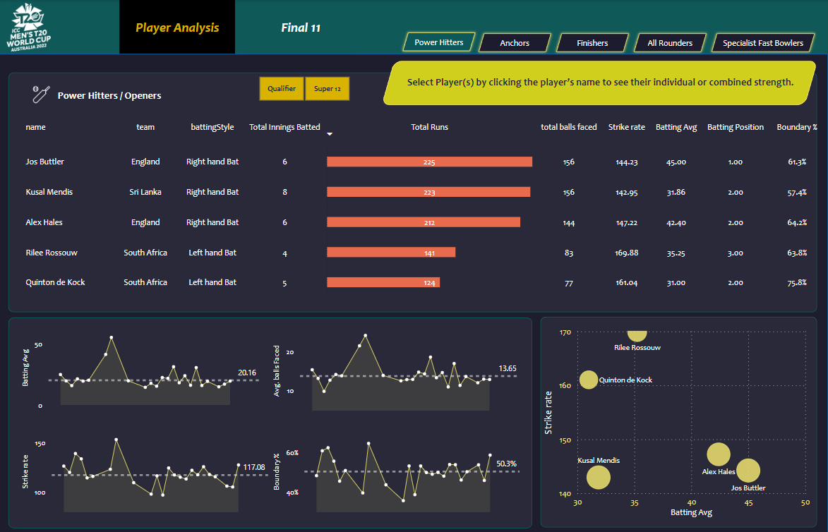

Slide 12
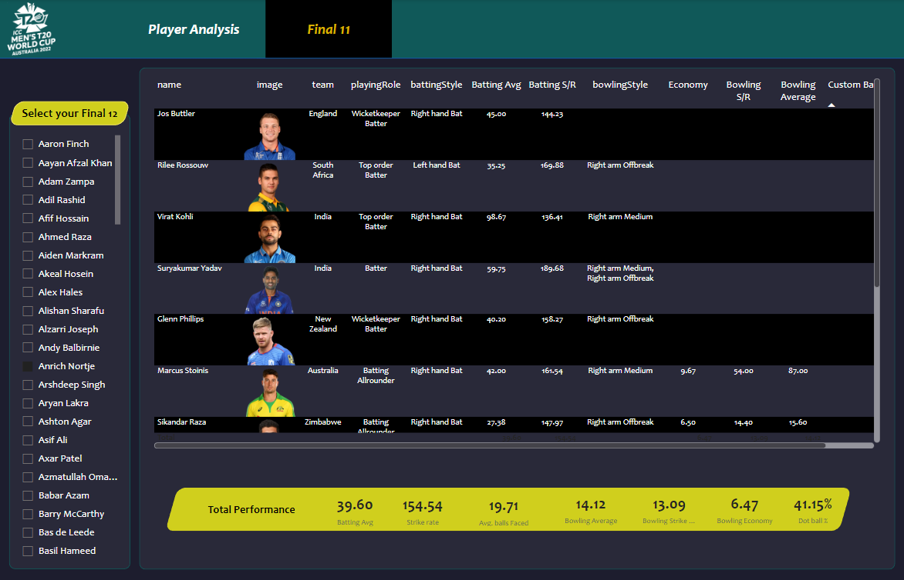

Slide 13
Best 11 Players
Jos Buttler
Rilee Rossouw
Virat Kohli
Suryakumar Yadav
Gelnn Phillips
Marcus Stoinis
Sikandar Raza
Shadab Khan
Sam Curran
Shaheen Shah Afreedi
Anrich Nortje

Slide 14
Thankyou!!

